Slide 1
Charter School Facility Costs
Leonie Haimson, Emily Carrazana and Patrick Nevada
Class Size Matters
www.classsizematters.org
9.17.19

Slide 2
Total spending= matching funds to co-located public schools + charter subsidies for space
We estimate that the total amount of public funds spent from FY 2014 to FY 2019 on matching funds for facility upgrades for co-located public schools and for charter school lease assistance reached $377.5 million.
This includes $87.6 million in projected state reimbursements for charter lease subsidies
The cost is rapidly growing every year and totaled more than $125 M in FY 2019.

Slide 3
Matching funds for co-located public schools
NY State law passed in 2010 that matching funds should be provided to public schools co-located w/charters that spend over $5000 on facility upgrades per year.
The amount spent by the charter school is supposed to be matched for each public school that shares the same building; and often there is more than one public school that does..
DOE matching funds for public schools co-located with charter schools totaled $20 to $25 million per year between FY 2014 and FY 2019, for a total of $131.6M.
Yet during that period, about $22.1 million in charter school expenditures on facility upgrades were not matched to the public schools that shared their buildings, a shortfall of about 14%
Total spending AND shortfall growing each year

Slide 4
The reason the charter project expenditure does not exactly match the total DOE cost if fully matched is that many charter schools are co-located with more than one public school in the same building – each of which are supposed to get matching funds.
Notes:
Report Figure 1

Slide 5
Notes:
Report Figure 3

Slide 6
Notes:
Report Figure 2

Slide 7
The 15 public schools that lacked the most in matching funds for facility upgrades were ALL co-located with Success Academy charter schools.
Following are the three public schools that lacked the most in matching funds:
Which co-located schools were deprived the most of matching funds?
Notes:
This likely reflects the high level of annual spending made by Success to upgrade its facilities.

Slide 8
Mickey Mantle School (M811)
Mickey Mantle School (M811) lacked a cumulative $1.5 million in matching funds from FY 2014 to FY 2019.
The Mickey Mantle School is a D75 school that enrolls students with multiple disabilities, including autism, emotional/behavioral difficulties and/or significant language and communication disorders.
The school is located in two sites in Harlem; the one in D3 is missing about $588,000 in matching funds while the school in district 4 is missing $913,000.
Co-located with Success Academy Harlem 1 & 3.

Slide 9
P.S 368 (K368)
P.S 368 (K368) is another District 75 school that is also located in two sites, one in Bedford Stuyvesant and the other in Cobble Hill Brooklyn.
The school serves K-12th graders with autism and emotional disturbances
Co-located with Success Academy Bed-Stuy 1 & Success Academy Cobble Hill.
The schools in Cobble Hill and Bedford Stuyvesant failed to receive about $393,000 and $805,000 respectively, amounting to about $1.2 million in missing matching funds for the school over the same period.

Slide 10
Mosaic Preparatory Academy/ P.S 375 (M375)
Third highest in lacking matching funds was Mosaic Preparatory Academy or P.S. 375 (M375), a zoned elementary school in East Harlem
Its students reside in a neighborhood that includes three large public housing complexes.
The school is co-located with Success Academy Harlem 3.
Mosaic lacked more than $913,000 in matching funds from FY 2014 to FY 2019.

Slide 11
Why does the DOE not fully match the funds spent?
We don’t know.
It may be DOE interprets the law as meaning they don’t have to match any individual projects undertaken by charters that cost under $5000, even if the total amount the charter school spent on facility upgrades is over $5000 per year.
But that interpretation doesn’t seem consistent with the language of the law or the Chancellor’s regs

Slide 12
NYS Education Law 2853
“For any capital improvements or facility upgrades in excess of five thousand dollars that have been approved by the chancellor, regardless of the source of funding, made in a charter school that is already co-located within a public school building, matching capital improvements or facility upgrades shall be made in an amount equal to the expenditure of the charter school for each non-charter public school within the public school building within three months of such improvements or upgrades”
The Chancellor’s regulation matches this language exactly.

Slide 13
Also this possible interpretation of law doesn’t make sense given huge disparities in some cases
Take example of Mosaic Preparatory Academy, public school co-located with Success Academy Harlem 3.
Lacked $662,315.17 in matching funds spent by Success Academy in FY 2019 alone.
Even if DOE didn’t believe it had to match each individual project under $5,000, that would have to mean that the co-located charter would have had to commission at least 132 separate renovation projects, each costing less than $5,000, to account for all the missing matching funds.

Slide 14
Also – why doesn’t DOE turn down more requests?
State law requires that the Chancellor must provide prior approval for any charter school renovations that cost more than $5,000.
Yet both KIPP and Success Academy renovate nearly every one of their charter schools every single year (100% and 99% respectively)
Success spends a significant amount each year – an average of $270,000 each year on each of its schools
There is no evidence that the DOE has ever turned one of their requests

Slide 16
Notes:
Report Figure 5

Slide 17
Notes:
Report Figure 4

Slide 18
Lease Subsidies
In 2014, charter law amended so that NYC DOE would have to give space for all new or expanding charters in public schools
Or DOE had to pay directly for their private space
If DOE didn’t offer space, or the charter didn’t like what was offered, the charter could appeal to State Ed Dept. to obligate DOE to provide a per student subsidy to pay for private space.
DOE expenditures for the per student subsidy would be 60% reimbursed by NYS when total spending reached $40 million

Slide 19
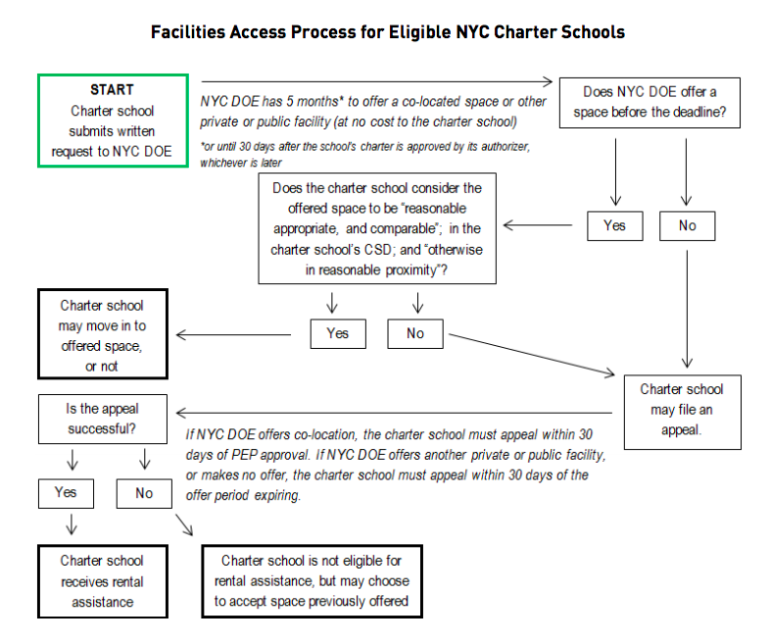
Process for lease subsidies is complex
Source: NYC Charter Center

Slide 20
Lease Subsidies
In our analysis of the 132 NYSED Commissioner decisions on charter school facility appeals made from FY 2015 to FY 2019, only five were dismissed. Two were later appealed again and subsequently prevailed.
In FY 2019, DOE is projected to spend about $83.6 million in lease subsidies for charter schools, with an estimated $50 million of that reimbursed by the state
Cost is rapidly increasing each year, as is the cost of leases directly held by DOE for buildings housing charter schools.

Slide 21
Amount spent per school on the lease subsidy for space has increased rapidly
The average projected amount received per school via the per student subsidy was about $220,000 in FY 2015
This grew to approximately $880,000 in FY 2019

Slide 22
Notes:
Report Figure 7
Source: Checkbook NYC, DOE Lease Report FY 2015-2019, DOE Charter Lease Report FY 2015 - 2019
*The annual amount spent has rapidly increased from $13.3 million in FY2015, to $100.7 million in FY2019

Slide 23
8 Charters receive lease subsidies though their buildings owned by related parties
DOE is providing per student lease subsidies for eight charter schools whose facilities are owned by related parties
This means the building is owned by their charter management organizations or an affiliated LLC or foundation.
The total for such expenditures amounts to about $14.8 million in DOE expenditures since FY 2015

Slide 24
Examples
DOE spent $2.2 million for two Success Academy charter schools in FY 2019 located in Hudson Yards complex on the west side of Manhattan, the most expensive real estate development in NYC.
Yet Success Academy Charter Management Organization purchased the space for $68 million in 2016, with at least $20 million of that donated by Robertson Foundation.
In another case, the city paid $461,965 in lease subsidies in FY 2019 towards the rental costs of Beginning with Children II charter school in Brooklyn.
Real estate records show Beginning with Children Foundation bought its building for only ten dollars in 2017 from the Pfizer Corporation.

Slide 25
Harlem Village Academy
Since FY 2015, the DOE has provided per-student lease subsidies of nearly $3.2 million to Harlem Village Academy – West (M335) for an elementary school located on 74 West 124th Street.
The building was purchased in 2012 by “HVA 124 LLC” for $13 million according to property records, a limited liability company in which the HVA CMO is the sole member. This was before the charter amendment requiring subsidies was passed.
Jonathan Gray COO of Blackstone donated $10 million for the purchase of the building and an additional $15 million for building renovations.
Part of the renovation costs were also paid by federal New Market Tax credits.

Slide 26
Harlem Children’s Zone Promise Academy II
Since FY 2015, the DOE has provided approximately $2.1 million in lease subsidies to Harlem Children's Zone Promise Academy II Charter School (M341) in a building on 35 East 125th Street.
According to city records, this building has been owned by “Rheedlen 125th Street LLC” since 2000, which is a subsidiary of Harlem Children Zone network and their sole member.

Slide 27
Family Life Charter Schools
Family Life Charter Schools (FLACS) received $862,696 from DOE in lease subsidies in FY 2018.
FLACs was founded in 2000 in partnership with the Latino Pastoral Action Center (LPAC), headquartered in the same building on 14 West 170 St. in the Bronx.
Property records show the building is owned by LPAC and tax forms show that they receive rental income.

Slide 28
East Harlem Scholars Academy
East Harlem Scholars Academy (M518) is located in 2050 Second Ave. and has been receiving lease subsidies from DOE every year since FY 2016, amounting to $3.1 million.
Property records show that the building is owned by “East Harlem Center, LLC” the “wholly owned subsidiary” of East Harlem Tutorial Program, the management organization of the charter school.
According to NY Daily News, the building cost $30 million to construct, with $15 million donated by the Simons Foundation

Slide 29
7. Metropolitan Lighthouse Charter School
Metropolitan Lighthouse Charter School is located on 180 W. 165th street in the Bronx.
The school has received $2.6 million in lease assistance from DOE since 2017.
According to its financial statements, the school is the sole member of “180 W. 165th Street LLC”, a limited liability company created in June 14, 2017 to borrow bonds to purchase the building.
On December 1, 2017, the charter school obtained low-interest and tax-exempt financing of $25.7 million from Build NYC Resource Corporation, to cover the purchase price of the building and renovations.

Slide 30
DREAM Charter School
The DOE paid lease assistance to DREAM Charter School for FY 2018, amounting to $433,630 for a 9th grade level expansion at a building at 1991 Second Avenue.
The DOE contributed $32.5 million for the school’s construction, according to the 2010-2014 School Construction Authority capital plan.
According to city records, the building itself is owned by the New York City Housing Authority.
We could not ascertain from the school’s financial statements what rent, if any, they pay for the space.

Slide 32
Notes:
Report Figure 8
Source: DOE Lease Reports FY 2015-2019, DOE Charter Lease Report FY 2015-2019, Checkbook NYC

Slide 33
Opportunity Costs
About $125 million in city funds were spent in FY 2019 on facility matching funds and lease assistance
If this amount were instead spent on annual payments for bonds to finance school construction, that would pay for approximately 26,550 additional school seats in the five-year school capital plan, according to the IBO.
This would be a nearly 50 percent increase in spending on school capacity.

Slide 35
Policy questions and proposals

Slide 36
Should NYC be obligated to pay for private space for charters at all?
The cost of lease subsidies and direct leases for charter schools is more than $100M per year and is still growing fast, as many authorized charters have yet to open, others are still growing and the per student amount, linked to per student expenditures, will also increase over time.
NYC is the only school district in the nation required by law to cover any of the cost of private space for new and expanding charter schools.
The NY State Legislature should consider if the state law requiring the DOE to pay for the cost of private space for charter schools should be amended or rescinded.
If the state wants to subsidize the acquisition of private space by charter schools, perhaps the state should be responsible for paying for the entire amount.

Slide 37
Officials should examine DOE’s spending on schools co-located with charters
City or State Comptroller or another independent auditor should analyze whether the apparent shortfall of over $22M in DOE matching funds to co-located public schools is equitable and complies with the law.
Determine if it is true that the DOE rarely if ever refuses a request by a charter school to spend substantial amounts on renovating its space, even if it is doing so each year.
If this is true, why?

Slide 38
Independent audit should investigate amount DOE spent on lease subsidies for charter school rent is correctly applied
In FY 2019, DOE spreadsheets appeared to show that 39 charter schools were projected to receive lease subsidies amounting to more than the listed base rent .
This is despite the charter law states that the “lease subsidy” must be equivalent to the lesser of the per pupil subsidy or the total base rent.
The spreadsheets offers no explanation for this anomaly.

Slide 39
Audit should also examine whether DOE should require charters go through appeal process rather than leasing schools directly for them
DOE is holding leases for eight private buildings housing nine charter schools that are not co-located with any public school in FY 2019.
If the DOE had provided these schools with subsidies for space after they went through an appeal process, instead of leasing the buildings directly for the charter schools, DOE would have spent $3.7 million in lease assistance, after accounting for state subsidies.
This is $9.5 million less than what DOE is expected to spend for FY 2019 in rental costs for these same schools
Notes:
This is partly b/c they do not get any state subsidies for these direct lease payments unless charters through the appeal process.

Slide 40
Auditors should analyze whether DOE should be providing lease subsidies for charters whose space is owned by related parties
Determine if the State legislature intended for taxpayer funds to be expended to cover the cost of buildings owned directly by the CMO or related organizations, and if not, what should be done as a result.
Analyze whether self-dealing is involved in any of these cases, and whether the charter school is paying more than fair-market value to its related CMO or other organization.

Slide 41
IBO or another independent analyst should assess whether the 72% increase in per-student subsidy for charter rent since 2016 is reasonable
In the 2016-17 school year, the 20% per student subsidy amounted to $2,805.40 per student.
In April 2018, the overall funding amount for charter school students was raised to $15,307.
At 30% per pupil subsidy, the lease subsidy was raised to $4,727.70 per pupil during the 2018-2019 school year.
As of April 2019, per pupil funding for NYC charter schools again increased to $16,154 so that the student lease subsidy is approximately $4,846 per pupil for FY 2020.
Thus, the per pupil subsidy for charter rental assistance in New York City has increased by nearly 72 percent since FY 2017. Is this fair compared to actual rental costs in NYC?

