Slide 1

Texans Advocating for
Meaningful Student Assessment
(TAMSA)
Save Texas Schools Seminar – February 21, 2015

Slide 2
TAMSA Overview
Evolution of Texas Student Assessments
Concerns About Current STAAR Testing
TAMSA Advocacy Objectives
How You Can Help

Slide 3

Who Is TAMSA?
A statewide, grassroots organization comprised of concerned parents and other community members

Slide 4
Mission
Improve public education in Texas through the use of meaningful and effective student assessments, allowing:
  more productive classroom instruction
  more efficient use of public funds

Slide 5
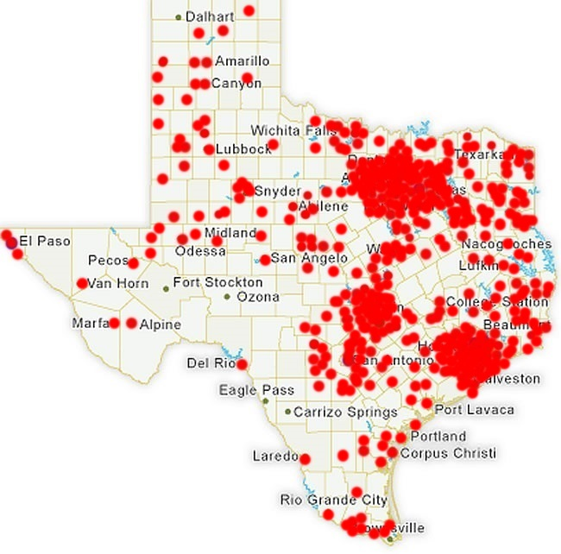
Statewide Membership
Texas Education Service Centers:
Edinburg
Corpus Christi
Victoria
Houston
Beaumont
Huntsville
Kilgore
Mount Pleasant
Wichita Falls
Richardson (Dallas)
Fort Worth
Waco
Austin
Abilene
San Angelo
Amarillo
Lubbock
Midland
El Paso
San Antonio
*Pins represent where TAMSA has members (as of 7/1/14)

Slide 6
Parental Involvement is Critical to Policy Making
Legislators understand that parents have an everyday perspective on what is and is not working in public education. The current system is broken.
Momentum for reform continues to build.
TAMSA’s SlideShare presentation was in the top 1% most viewed in 2013.
Within 48 hours of HB 5 being signed into law, TAMSA had over 100,000 views on Facebook.

Slide 7
TAMSA’s Motivation
Provide parents’ voice on the consequences of excessive standardized testing
Ask decision-makers to consider the purpose of standardized tests and ensure that every test is meaningful
Demand that assessments be used to support our children, not to close down our schools
Promote accountability as a means by which we measure achievement in multiple ways, not just based on standardized tests

Slide 8
Recent Polls Shows Bi-Partisan Support of Reducing State-Mandated Tests
A majority of respondents from both political parties (58% Reps; 64% Dems) felt that reducing the number of standardized tests students are required to take would be effective in improving K-12 public education in Texas. ¹
A second poll in Feb 2014 similarly showed “reducing the number of standardized tests students must take was identified as one of the most effective changes Texas could make in public education.” 61% Reps and 69% Dems agreed cutting tests would help public education in Texas. ²
¹ University of Texas / Texas Tribune Statewide Survey conducted in June 2013
2 University of Texas/Texas Tribune Statewide Survey conducted in February 2014

Slide 9
TAMSA Overview
Evolution of Texas Student Assessments
Concerns About Current STAAR Testing
TAMSA Advocacy Objectives
How You Can Help

Slide 10
Texas Student Assessment Programs
Year Began | Name | # of High Stakes tests*
1979-1984 | TABS | 0
1984-1990 | TEAMS | 3
1991-2003 | TAAS | 3
2003-2010 | TAKS | 8
2012 | STAAR/EOC | 19
2014 | STAAR/EOC | 9
High-stakes tests are exams that must be passed to either advance to the next grade level or graduate. High-stakes also include using test scores to determine teacher evaluations and/or school accountability.

Slide 11
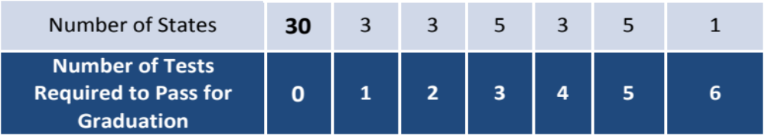
State High-Stakes Exam Comparison
Texas requires more state-mandated, high-stakes tests for high school graduation than most other states¹
Of the top 10 states ranked by NAEP in 8th grade math or reading in 2013, over half of the states require no exit exams for high school graduation.
Of the states that require exit exams, ALL BUT 3 offer alternatives, such as portfolios, to earn a high school diploma.
Texas ranked #19 in math and #39 in reading by NAEP, and requires students to pass 5 End of Course exams to graduate.
¹ Data from Center of Education Policy: “State High School Exit Exams: A Policy in Transition” 9/12

Slide 12
Limited Benchmark Tests
“Benchmark tests” are district-required assessments designed to prepare students for state-mandated (STAAR) tests.
HB5 permits ONLY TWO (2) per year per subject tested.
If you have any concerns about benchmarks in your child's school, check with your principal and school district board of trustees.

Slide 13
Return on Investment of Testing
Parents, employers, & taxpayers ask:
How much are we spending on state standardized tests?
What is the purpose of these tests?
Do these tests help prepare students for college or careers?

Slide 14
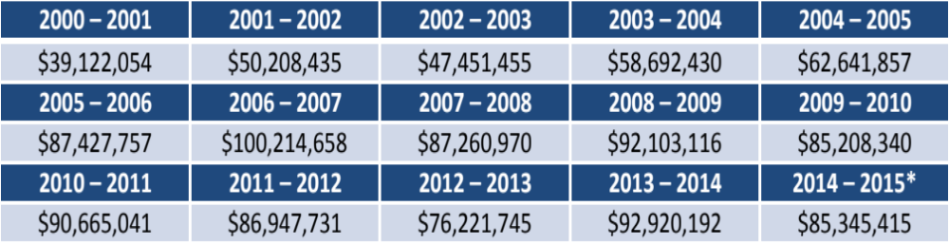

Texas Tax Dollars Paid to Pearson
* 2014-2015 data estimate based on actuals through July 2014.
TOTAL 2000 – 2015
$1,142,431,196

Slide 15

Lost Opportunity
Dollars spent on testing:
$2 EVERY SECOND of EVERY DAY for the last 15 years.
$50,400 every 7 hours.
Compare that to:
Most districts spend under $2 for a lunch for a hungry student.
$50,400 could pay for 3 teachers per day or 1,277 teachers per year every year.

Slide 16
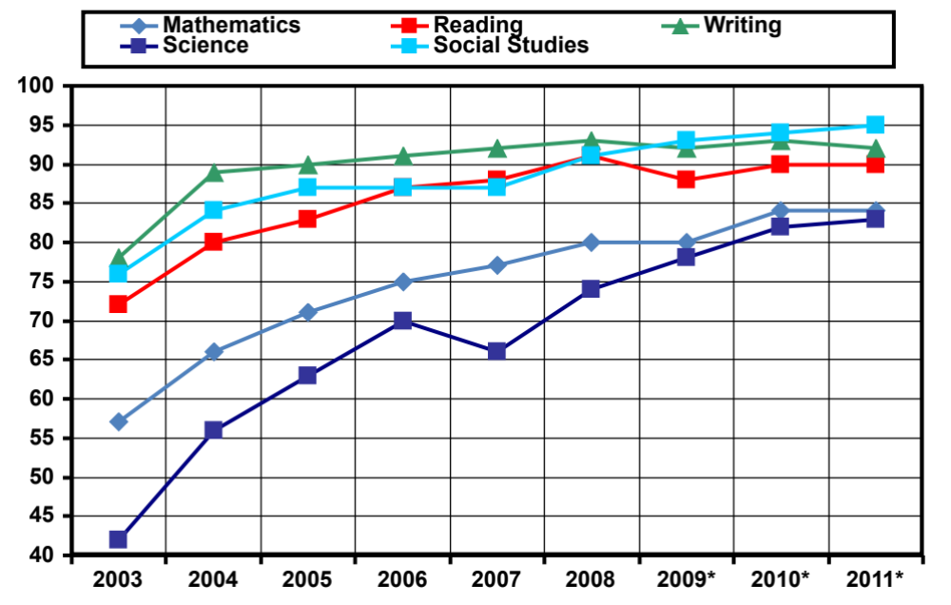
TAKS% Passing: Sum of All Grades
2003 – 2011
*2009 – 2011 include TAKS-Acc

Slide 17
STAAR Passing: Sum of All Grades
2012 - 2014
Scores represent initial Spring testing.

Slide 18
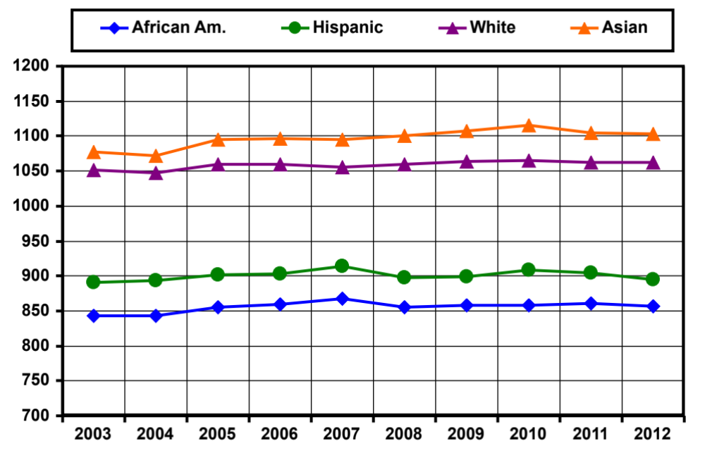
Texas Mean SAT Scores
2003 – 2010 – NEED TO ADD 2011 - 2013
(Maximum Score 1600)

Slide 19
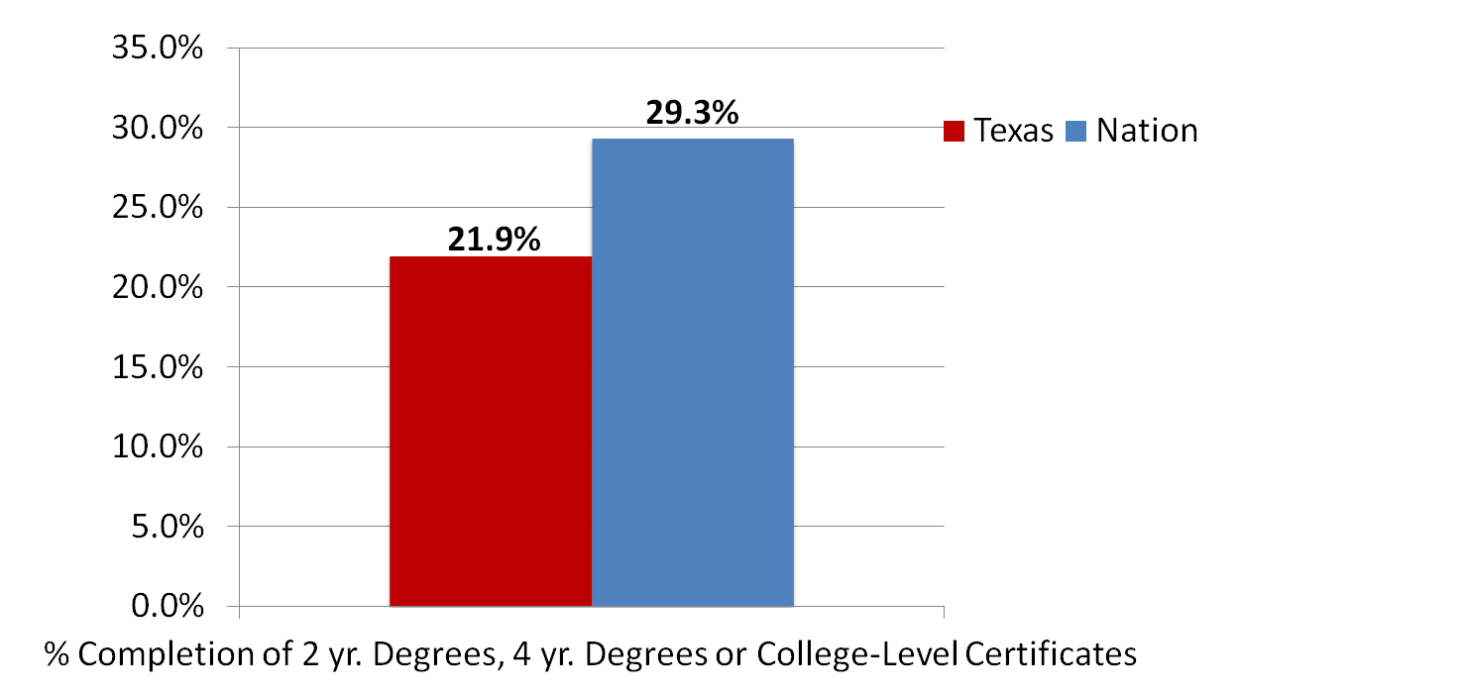
College Persistence
Success in Higher Education Overall
*Source: National Center for Higher Education Management Systems (NCHEMS) report “A New Measure of Educational Success in Texas: Tracking the Success of 8th Graders Into and Through College” Feb. 2012

Slide 20
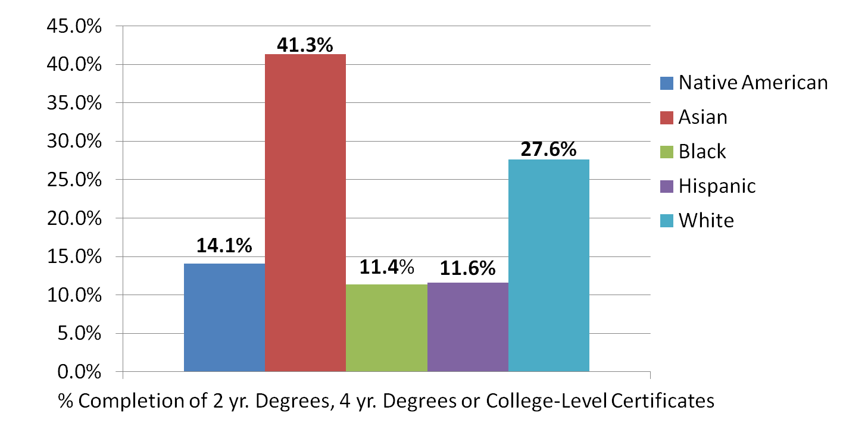
College Persistence
Success in Higher Education by Ethnicity
*Source: National Center for Higher Education Management Systems (NCHEMS) report “A New Measure of Educational Success in Texas: Tracking the Success of 8th Graders Into and Through College” Feb. 2012

Slide 21
TAMSA Overview
Evolution of Texas Student Assessments
Concerns About Current STAAR Testing
TAMSA Advocacy Objectives
How You Can Help

Slide 22
What is the Purpose of the Tests?
STAAR tests are not diagnostic – they provide no substantive data or analysis to help children improve.
Norm Referenced Tests (NRTs), such as ITBS, ACT, SAT, are nationally accepted exams that provide pages of detailed diagnostic data and suggestions for improvement.
As a state, our tax dollars would be better spent on assessments that help, not punish, children

Slide 23
Impact of 2 decades of standardized testing
In Texas, SAT scores hit a 22 year low; reading hit the second lowest level.*
"It is disturbing to see the trend … where we raised the bar, raised standards, and tested more intensely, and all during that time we are now seeing a precipitous drop in our college readiness testing mechanism. I find that both puzzling and troubling.”
-Representative Jimmie Don Aycock
Texas House Public Education Committee Chairman
October 8, 2014
*http://www.dallasnews.com/news/local-news/20141007-texas-sat-math-scores-hit-a-22-year-low.ece

Slide 24
Time for a Paradigm Shift
- For decades educators have become accustomed to high stakes testing. Many educators believe that a state test somehow represents value. This is based on years of conditioning. As parents, we believe educators freed of high stakes testing can work miracles.
- Texas should be proactive in providing guidance and assistance to schools instead of reactive in punishing based on test scores.

Slide 25
Grades 3-8 State-Mandated Tests
The same grades and subjects are tested with TAKS and STAAR, but STAAR exams are timed and more rigorous.
Grade | Math | Reading | Writing | Science | S. Studies
3 | X | X
4 | X | X | X
5 | X | X |  | X
6 | X | X
7 | X | X | X
8 | X | X |  | X | X
Federal requirements dictate 14 tests; Texas administers 17.

Slide 26
High School State-Mandated Tests
Five STAAR EOCs must be passed for graduation
TEXAS 5 STAAR EOCs
Must Pass to Graduate
  English I
  English II
  Algebra I
  Biology
  US History
FEDERAL REQUIREMENTS
NOT High-Stakes
    Reading
    Math
    Science
Starting with the 2015-16 school year, school districts, at their option, may add English III and Algebra II EOCs

Slide 27
Are the STAAR Tests Appropriate?
Eight year old third graders must sit quietly at desks for 4 hours for 2 consecutive days to take STAAR tests.
High school freshman and sophomores must sit at desks for 5 hours to take English EOC exams. The SAT and ACT exams test math and English (and science) in less than 4 hours.
  22% of the questions are field questions; including 1 of the 2 required essays. NRTs typically have 10% field questions and no essay is a field question
¹ Times Record News, Educators Challenge STAAR Questions, May 12, 2014

Slide 28
Drop-Out Projections
As of January 2015, there are 287,865 students in the Class of 2015
Of these students, at least 28,117 (10%) have not passed all the required EOCs, and are off track to graduate. What is the state doing for these thousands of students?
Removal of high stakes (requirement for graduation) would help put these on track to graduate (as is done in more than half of the states).

Slide 29
Lack of State Information on Students
Perhaps as troubling as the 10% off track to graduate is the lack of explanation of what has happened to approximately 100,000 students.
In Fall 2011 as the Class of 2015 began its 9th grade year, TEA records show 393,553 students enrolled (http://www.tea.state.tx.us/acctres/Enroll_2011-12.pdf, p. 16)
In June 2013, TEA records show 287,865 in the class (http://www.tea.state.tx.us/news_release.aspx?id=25769811943)
What happened to 105,688 students?

Slide 30
Is It Worth It?
Taxpayer Expense: $1.2 Billion (minimum)
College and Career Ready: No measurable improvement
Success in Higher Education: Below national levels
Dropout Forecast: Troubling
Validity: Unknown
Appropriate: No

Slide 31
TAMSA Overview
Evolution of Texas Student Assessments
Concerns About Current STAAR Testing
TAMSA Advocacy Objectives
How You Can Help

Slide 32
General Assessment Objectives
Administer assessments for diagnostic purposes to support student learning
Require no high-stakes for individual students: no performance requirement for grade promotion or high school graduation
Decrease time spent on state-mandated testing, including shortening state-designed exams.
Eliminate all field test essay questions, and reduce the number of multiple choice field test questions
Ensure that state-mandated exams are valid and appropriate

Slide 33
Specific Legislative Recommendations
No more tests than required under federal law.
Eliminate “high stakes” for grade promotion and graduation.
Graduation committee if retain high school high stakes.
Replace writing EOC with non-high stakes assessment.
Decrease length of tests and eliminate field test questions.

Slide 34
Specific Legislation to Watch
SB 149 (R-Seliger) – Allows graduation committees for students failing EOCs twice, satisfy 3 of 8 additional criteria including minimum GPA.
HB 741 (R-Huberty) – Students showing proficiency in 3-8 may skip a year of testing; requires federal waiver – same as HB 866 last session.
HB 743 (R-Huberty) – Testing & TEKS – test designed so that 85% students in 3-5 finish in 2 hours; 6-8 in 3 hours. Major review and overhaul of TEKS.
HB 829 (R – Zedler) – Require new state civics exam for graduation.

Slide 35
Legislation to Follow
HB 742 (R-Huberty) – Eliminate 3 tests (writing and SS) in 3-8 and US History EOC.
HB 774 (D-Gonzalez) – Eliminates writing and SS tests in 3-8.
HB 73 (D-Gonzalez) – Require alternative assessments for significantly cognitively disabled or medically fragile students based on ARD committee recommendation
HB 356 (D-Gonzalez) – Require TEA to seek waiver from fed testing requirements for students with significant cognitive disabilities.
HB 407 (D-Gonzalez) – TEA may by rule allow ISDs to conduct performance or portfolio based assessments in lieu of state standardized tests (grades 3-8 only).

Slide 36
Legislation to Follow
HB 1162 – (R- VanDeaver) – Eliminates High Stakes for students.
HB 1164 – (R – VanDeaver) – Revises Writing test to portfolio or district choice; no high stakes.
HB 959 (D- Menendez) – No more tests than NCLB requires for 3-8.
HB 1468 (R- Huberty) – Eliminates high stakes on writing for 3-8
HB 1469 (R-Huberty) – Eliminates high stakes on writing for 3-12

Slide 37
TAMSA Overview
Evolution of Texas Student Assessments
Texas State-Mandated Standardized Tests
TAMSA Advocacy Objectives
How You Can Help

Slide 38

What TAMSA Is Doing
Meeting with legislators, parents, teachers, community groups and businesses
Working with education and testing experts at UT Austin and other universities
Participating in media interviews and writing Op-Eds and Counter Op-Eds
Testifying in hearings before the House, Senate and State Board of Education
Communicating formally with TEA regarding STAAR implementation and testing issues
Updating members via e-mail, Facebook and Twitter

Slide 39
What TAMSA Members Are Doing
Joining TAMSA, liking us on Facebook, and following us on Twitter
Acting when TAMSA sends “Call to Action” instructions
Contacting elected officials to request support for education testing reform
Participating via social media in the debate about testing in Texas schools
Meeting with legislators in local districts
Testifying in Austin

Slide 40




Please Join Us
Sign up for updates on our website: www.tamsatx.org
Follow us on Facebook and Twitter www.facebook.com/tamsatx
www.twitter.com/tamsatx
Email: BoardMember@tamsatx.org

Slide 41

Testing Humor

Slide 42

“I believe in standardizing automobiles,
not human beings.”
Albert Einstein

